Slide 1
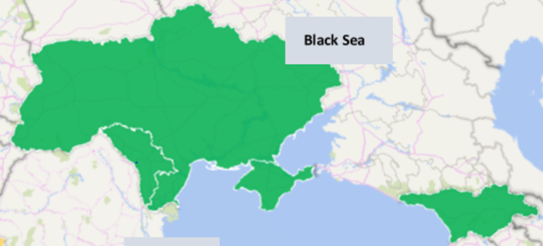
One Commercial Partner Transformation: selling Together in Corporate & SMB
Iurii Kilochytskyi
SMB Lead Black Sea (Ukraine, Georgia & Moldova)
iuriik@microsoft.com
December 2017

Slide 2
Our commitment to partners
Our mission at Microsoft remains steadfast – to empower every person and every organization on the planet to achieve more. Our partner ecosystem is at the forefront of bringing this powerful mission to life.
One Commercial Partner will accelerate cloud growth for all partners through three motions: Build-with, Go-To-Market, and Sell-with.
We’ll continue to transform our partner ecosystem, and simplify the programs and investment structure for our partners to drive growth and profitability.
We will provide the programs, tools, and resources you need to build and sustain a profitable, successful cloud business.

Slide 3
One Commercial Partner organization
Build-with
Go-To-Market
Sell-with
Partner specialization
Partner management Recruit, Develop, Launch, Grow
Offers into market and capacity requirements
Channel management territory success
Customer segmentation
Enterprise
ISV
Systems Integration
Managed Services
Channels
Partner Development Manager
Partner Market Advisor
Enterprise
Channel Manager
Industry & horizontal workloads & solutions
Partner Technical Strategist
Partner Channel Marketing Manager
Territory
Channel Manager
Small, Medium, Corporate
Cloud Solution Architects/Partner Technical Architects
Technical
Programs & Incentives

Slide 4
Build-with
Go-To-Market
Sell-with
Aligned by partner
Aligned by four solution areas
Aligned by industry
Partner Management
Modern workplace
Business applications
Applications & infrastructure
Data & AI
Channel Management

Slide 5
Black Sea OCP & SMC
Robert Bujak
TSM – Dublin/WWIS
Dmytro Naslavskyy
OCP/SMC Lead
Daniil Biktimirov
SI PDM Black Sea
Viktor Ianushenko
CTM Lead Black Sea
Katia Kind
OM – Black Sea
Serge Shmigaliov
Moldova
George Kophenlu
TCM CTM Black Sea
Tetiana Sereda
LSS Black Sea
Andrii Klimov
ISE - Ukraine
Iurii Kilochytskyi
SMB Lead
Black Sea
Elena Dmitrieva
SAM/C Lead Baltic/BlackSea
Svitlana Leus (MACH)
SI TSP Black Sea
Sofia Fedchyshyna (MACH)
PS OM – Black Sea
Igor Tregubenko
TSP – Black Sea
Oleg Myklashevsky
TCM SMB Ukraine
Iuliia Kolesnichenko
SAM Mgr – Baltic/Black Sea
Sergey Guk
(FY18 H1)
ISE - Ukraine
George Shevardnadze
ISE – Georgia
CTOM
Iryna Cherednychenko
CTOM Ukraine
PDM – shared Baltic/BlackSea
PDM – CEE HQ
Tetiana Kozer
Sales Development Specialist – Black Sea
Dimitris Darmis
CD PDM
Baltic/Black Sea
Nataliia Burlakova
CD TSP
Baltic/Black Sea
Oleksandr Ushakov
MSP PDM
CEE-HQ
Katerina Kiseliova
MSP PTS
CEE-HQ
Cloud Spark
Aleksandar Totovic
SI TSP Dynamics MCE
Jolanta Vasilevska
Cloud Spark Ukraine

Slide 6
Thank You! Questions?

